Slide 1






- ABP Community News
- What’s new with ABP 9
Alper EBICOGLU
@alperebicoglu
ABP Core Team Member
@ebicoglu

Slide 2





Today’s Gifts
https://abp.io/community/raffles
closes at 17:45 UTC
Notes:
3 JetBrains
https://admin.abp.io/Raffles/Draw/3a163790-9c7d-69d9-52b3-bb7f2993b4d6
ABP Personal License
https://admin.abp.io/Raffles/Draw/3a163792-2523-f369-3f8f-42d6b4c3af62

Slide 3
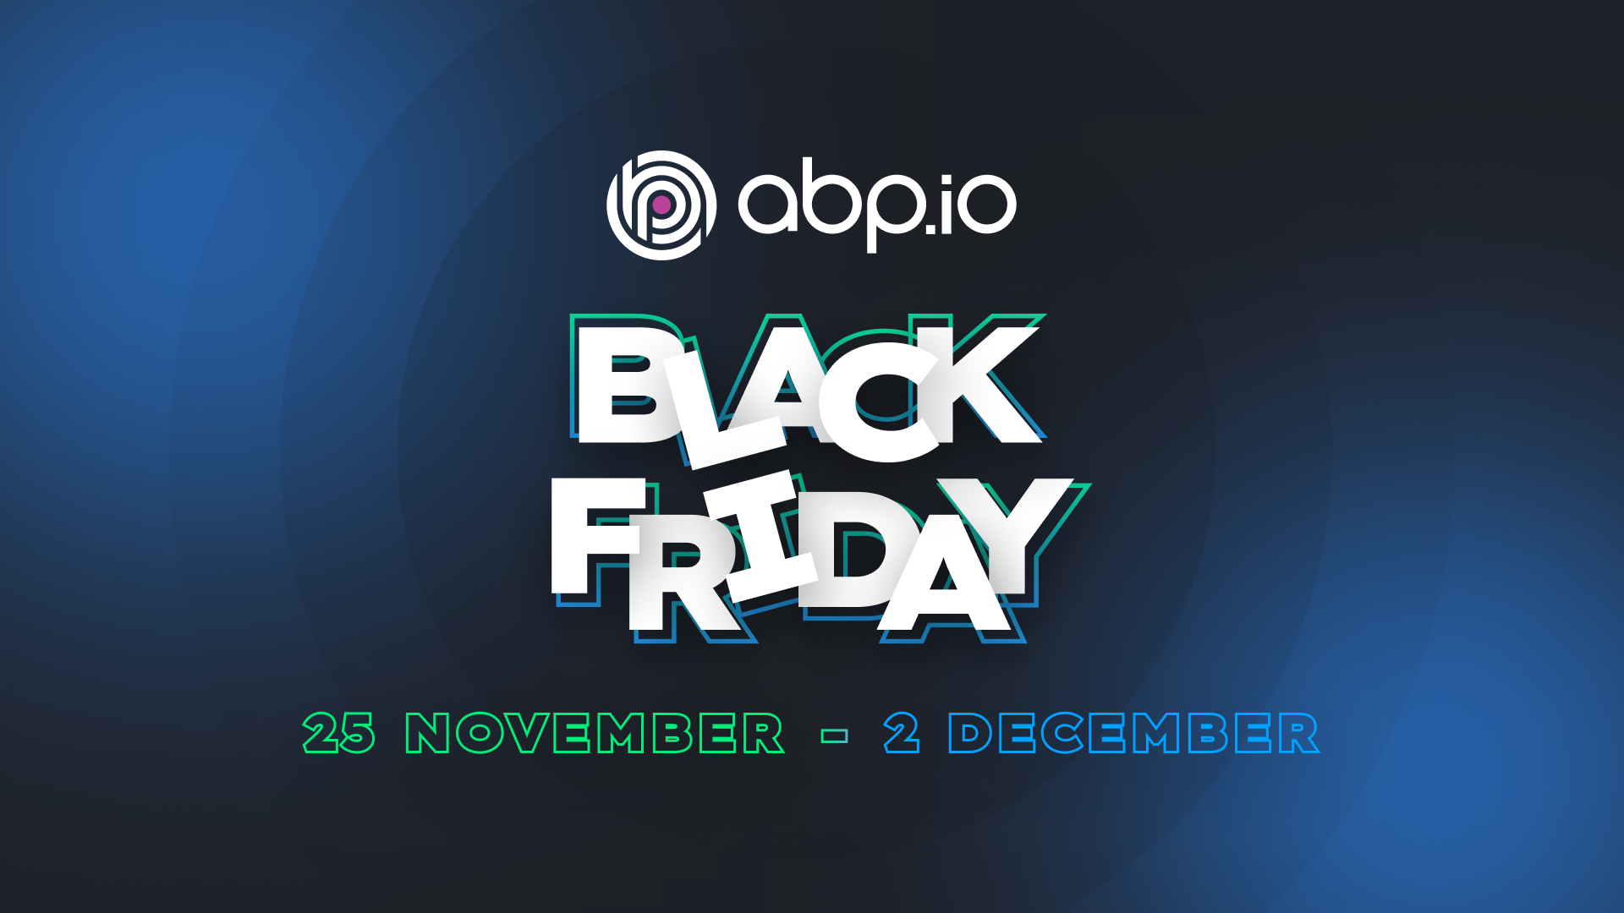
Black Friday 2024
Notes:
There will be a nice discount on ABP PRO licenses. Stay tuned

Slide 4
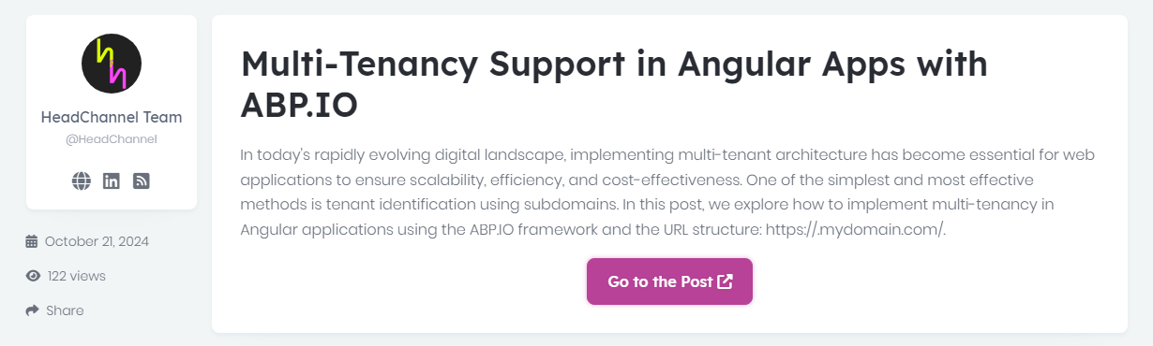

Community News
https://abp.io/community/articles/multitenancy-support-in-angular-apps-with-abp.io-lw9l36c5
Notes:
how to implement multi-tenant architecture in Angular applications using ABP Framework.

Slide 5
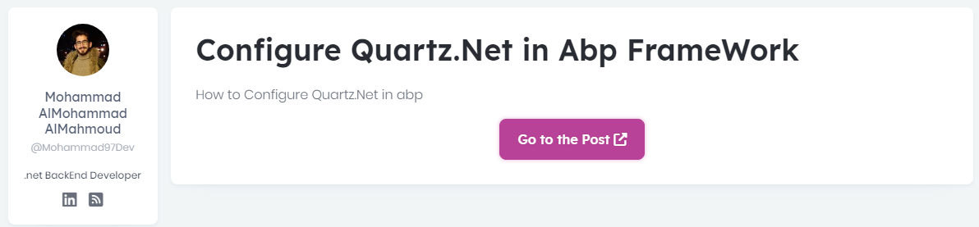

Community News
https://abp.io/community/articles/configure-quartz.net-in-abp-framework-3bveq4y1
Notes:
Step-by-step guide to using Quartz.Net in the ABP Framework for handling scheduled tasks and background jobs effectively. But ABP is well-integrated to Quartz. So no need to do anything.

Slide 6
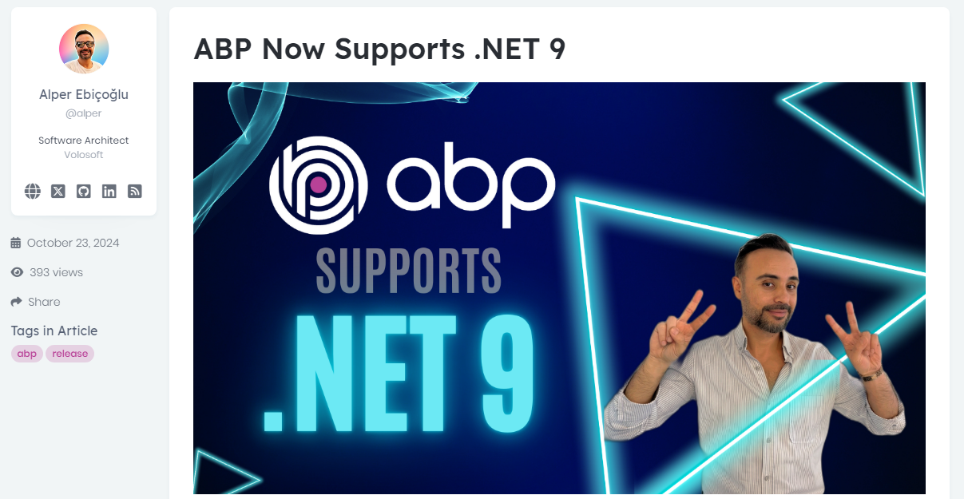

Community News
https://abp.io/community/articles/abp-now-supports-.net-9-zpkznc4f
Notes:
The ABP Platform is now compatible with .NET 9, bringing all the latest features of the framework to ABP developers.

Slide 7
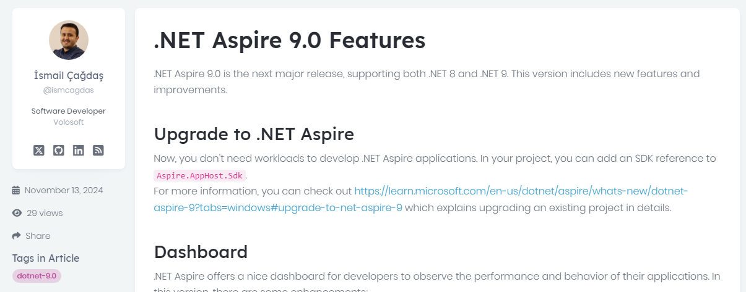

Community News
https://abp.io/community/articles/.net-aspire-9.0-features-q7nojisw

Slide 8
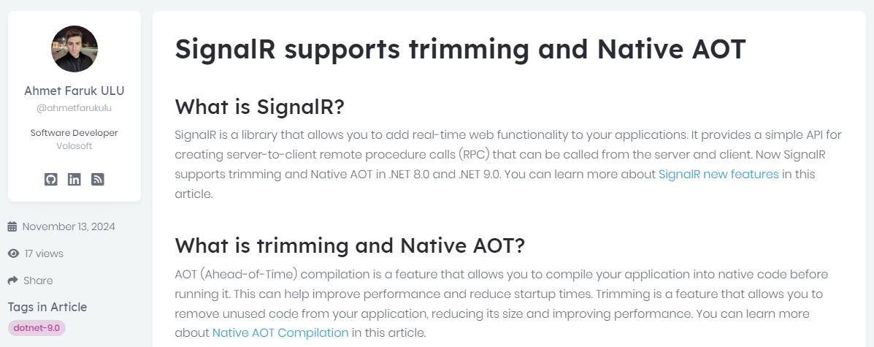

Community News
https://abp.io/community/articles/.net-9.0-signalr-supports-trimming-and-native-aot-4oxx0qbs
Notes:
SignalR comes with trimming and Native AOT support with .NET 9.

Slide 9
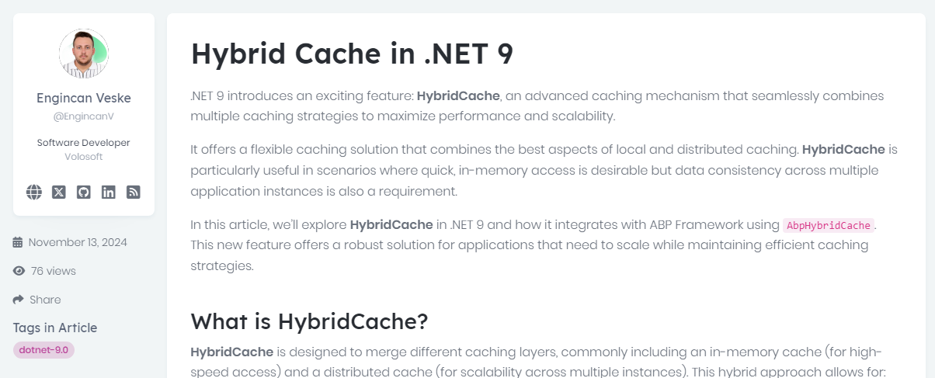

Community News
https://abp.io/community/articles/hybrid-cache-in-.net-9-5s0l2pa6
Notes:
With .NET 9, a new feature called HybridCache is announced.
It’s a new caching which combines multiple caching strategies to maximize performance and scalability.
Improves performance scalibity and allows automatic synchronization

Slide 10
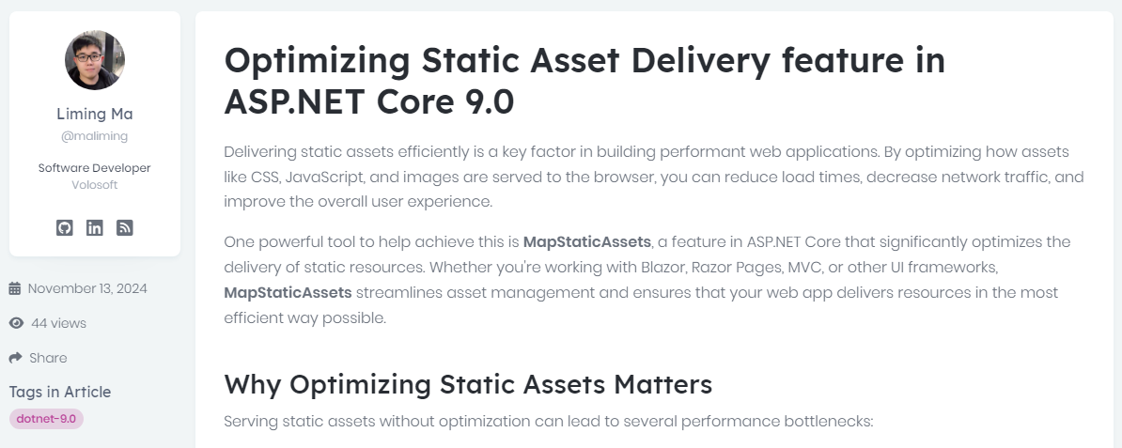
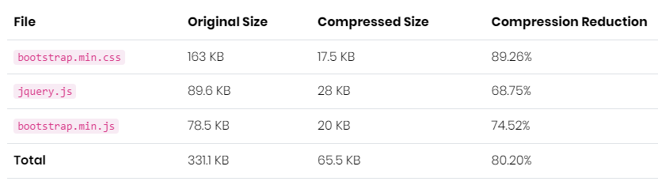

Community News
https://abp.io/community/articles/optimizing-static-asset-delivery-feature-in-asp.net-core-9.0-gyv140vb
Notes:
In ASP.NET Core 9.0, the Optimizing Static Asset Delivery feature introduces the MapStaticAssets middleware, designed to enhance the performance of web applications by improving the delivery of static assets such as CSS, JavaScript, and images.
Assets are precompressed using gzip during development and New or updated assets are automatically optimized during the build process, simplifying development workflows.
In a default Razor Pages template, assets like bootstrap.min.css and jquery.js are compressed by over 80%.

Slide 11
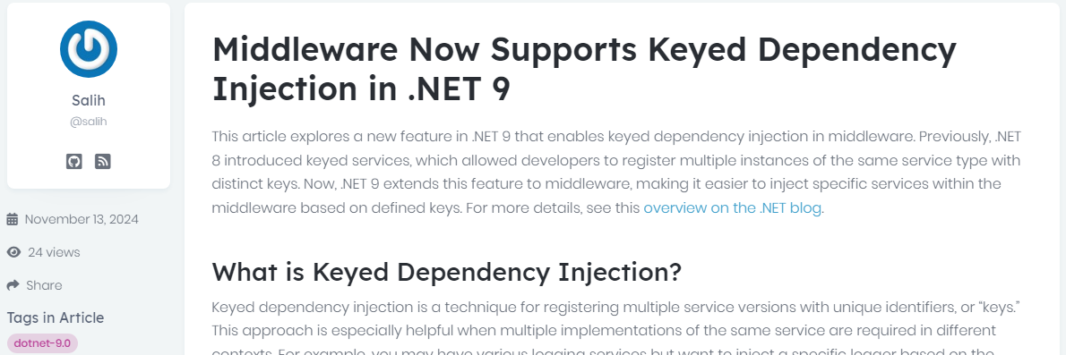

Community News
https://abp.io/community/articles/middleware-now-supports-keyed-dependency-injection-in-.net-9-4whni6rx
Notes:
In .NET 9, middleware components now support keyed dependency injection, allowing developers to inject specific service instances identified by unique keys directly into middleware classes.
Developers can register multiple implementations of the same service type, each associated with a unique key, and inject the desired instance into middleware by specifying the corresponding key.
This feature enables more granular control over middleware behavior by allowing different configurations or behaviors based on the injected service instance.

Slide 12
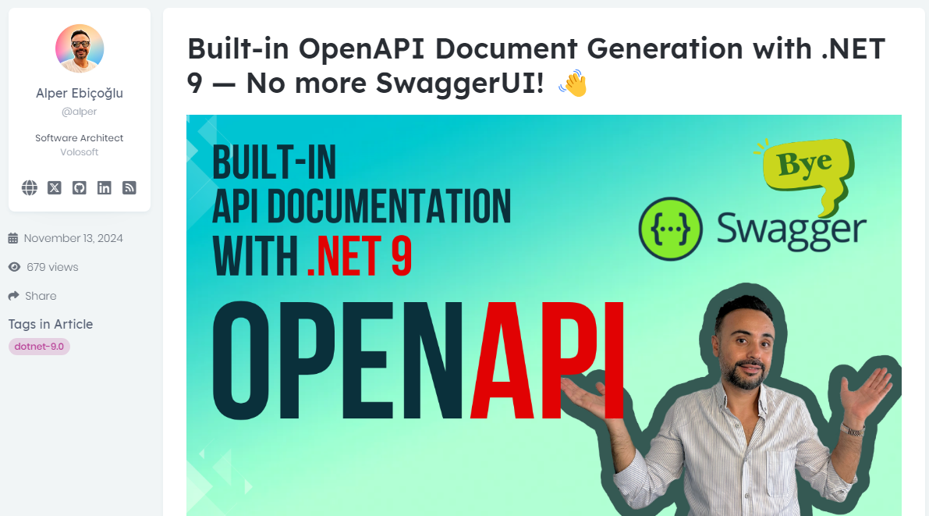

Community News
https://abp.io/community/articles/builtin-openapi-document-generation-with-.net-9-no-more-swaggerui--au56cck5
Notes:
In .NET 9 web templates Swagger is removed . Microsoft introduced a new package called OpenAPI.

Slide 13
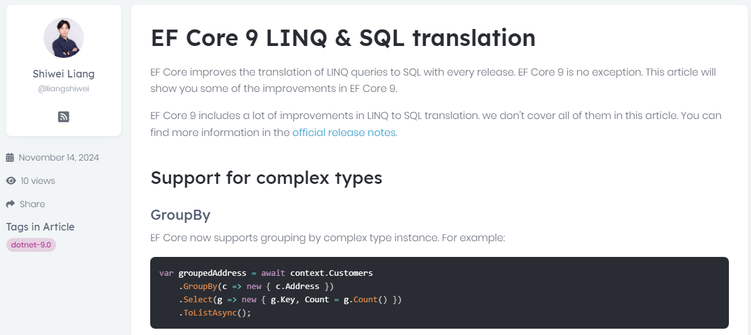

Community News
https://abp.io/community/articles/ef-core-9-linq-sql-translation-b7pzcj09
Notes:
In Entity Framework Core 9, LINQ-to-SQL translation has been significantly improved, allowing more complex LINQ queries to be accurately converted into SQL.
These enhancements reduce runtime errors and optimize database performance, making it easier for developers to write efficient and expressive queries.

Slide 14
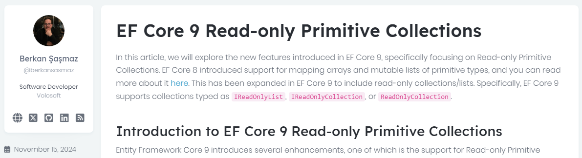

Community News
https://abp.io/community/articles/ef-core-9-readonly-primitive-collections-iy6ztbx8
Notes:
In this article, we will explore the new features introduced in EF Core 9, specifically focusing on Read-only Primitive Collections.

Slide 15
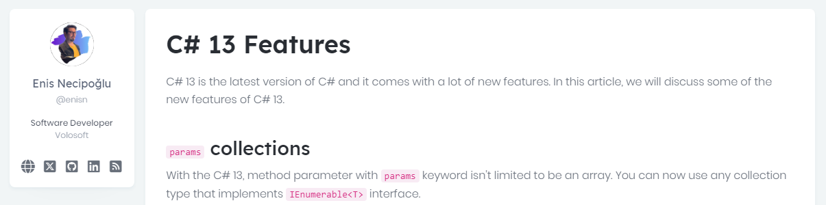

Community News
https://abp.io/community/articles/c-13-features-1aq5pzuy
Notes:
New features of C# 13

Slide 16
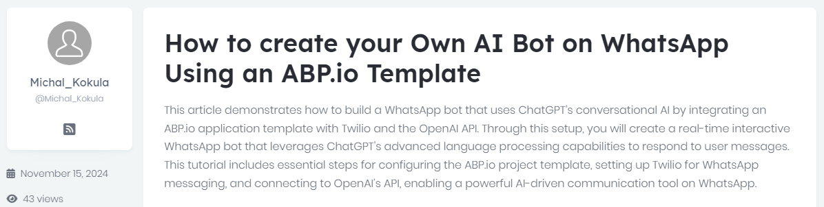

Community News
https://abp.io/community/articles/how-to-create-your-own-ai-bot-on-whatsapp-using-the-abp-framework-c6jgvt9c
Notes:
This article demonstrates how to build a WhatsApp bot that uses ChatGPT’s conversational AI by integrating an ABP.IO application template with Twilio ...

Slide 17
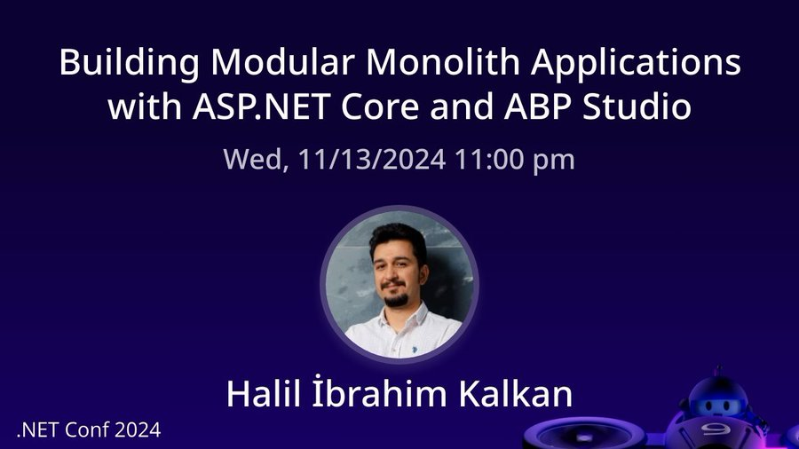

Community News
Notes:
Lead developer of ABP gave a talk in .NET Conf 2024.
The topic was “Building Modular Applications with ASP.NET Core & ABP”
In his session, he discussed building modular applications and mentioned how ABP Studio makes it easier to create fully modular systems with ASP.NET Core.

Slide 18
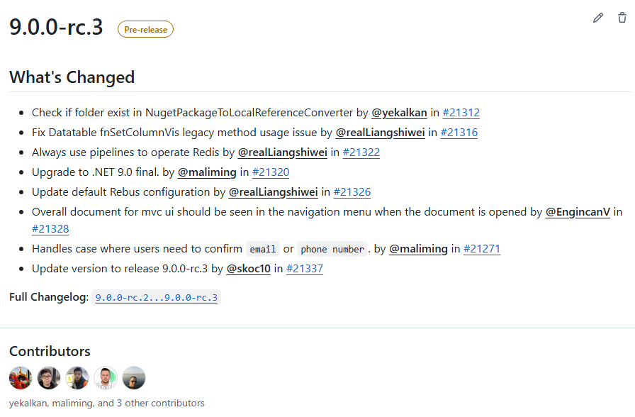
Community News

Slide 19
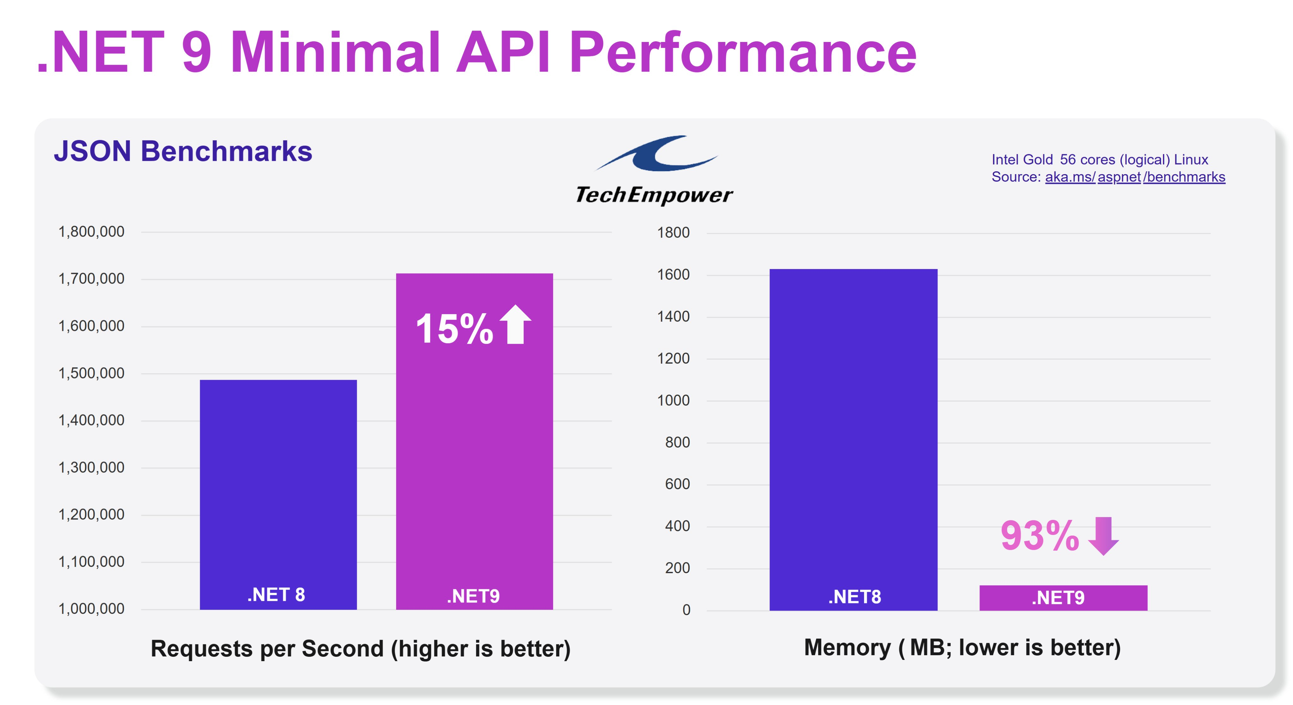
Community News
Notes:
how to enable multi language in ABP Framework

Slide 20
ABP 9 Improvements
Upgrade to .NET 9.0
Extension Property Policy
Wildcard Support for Redirect URLs
Google Cloud Storage BLOB Provider
Removal of React Native from Free Templates
ABP Suite Enhancements
CMS Kit Pro Feedback Feature Improvements
Notes:
Upgrade to .NET 9.0
Aligning with the latest advancements, ABP 9.0 has been upgraded to .NET 9.0. This transition leverages .NET 9's performance improvements and new features, ensuring that applications built on ABP are optimized for modern development standards.
Extension Property Policy
The new Extension Property Policy feature allows developers to define custom policies for module entity extension properties. This includes setting access controls, validation rules, and data transformations directly within ABP, enhancing flexibility and security in application development.
Wildcard Support for Redirect URLs
ABP 9.0 introduces support for wildcards in RedirectAllowedUrls configurations. This enhancement simplifies the management of permissible redirect URLs, especially in scenarios requiring broad URL allowances, thereby streamlining application security configurations.
Google Cloud Storage BLOB Provider
Expanding its cloud integration capabilities, ABP 9.0 now includes a BLOB provider for Google Cloud Storage. This addition offers developers more options for scalable and secure storage solutions within the ABP ecosystem.
Removal of React Native from Free Templates
To streamline offerings, React Native has been removed from ABP's free templates. This change allows the ABP team to focus on enhancing other mobile development options and maintaining high-quality support for existing frameworks.
ABP Suite Enhancements
ABP Suite has been updated to provide better naming conventions for multiple navigation properties to the same entity. This improvement reduces ambiguity and enhances code readability, facilitating more efficient development workflows.
CMS Kit Pro Feedback Feature Improvements
The CMS Kit Pro module's feedback feature has been refined to offer a more user-friendly experience. These improvements aim to enhance user engagement and provide developers with more effective tools for content management.

Slide 21
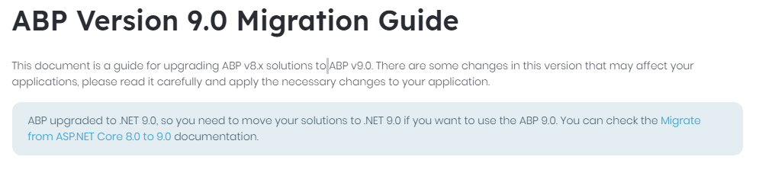

https://abp.io/docs/9.0/release-info/migration-guides/abp-9-0

Slide 22
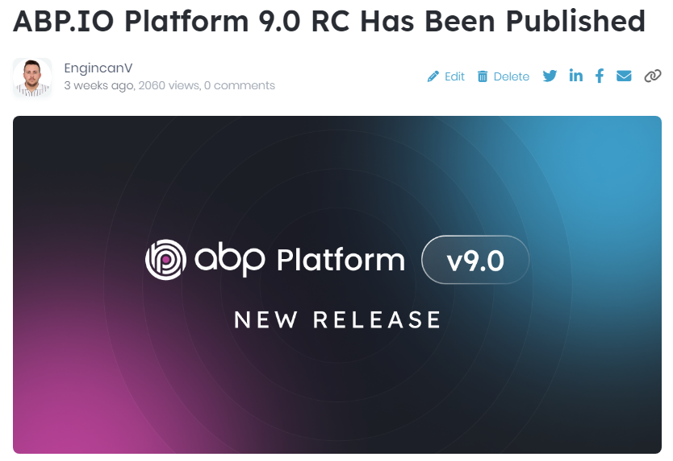

ABP 9 Improvements

Slide 23
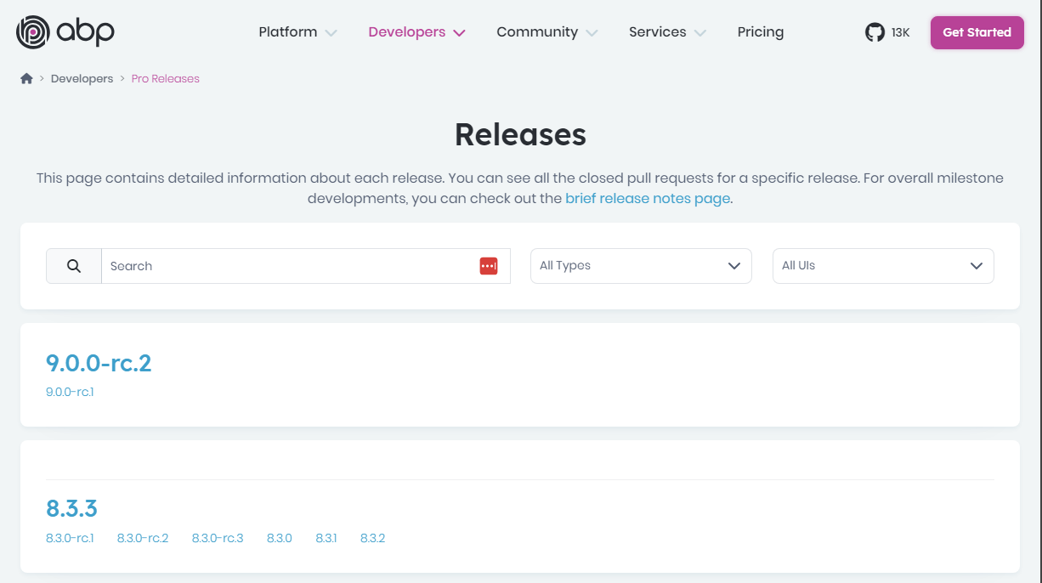

ABP 9 Improvements

Slide 24

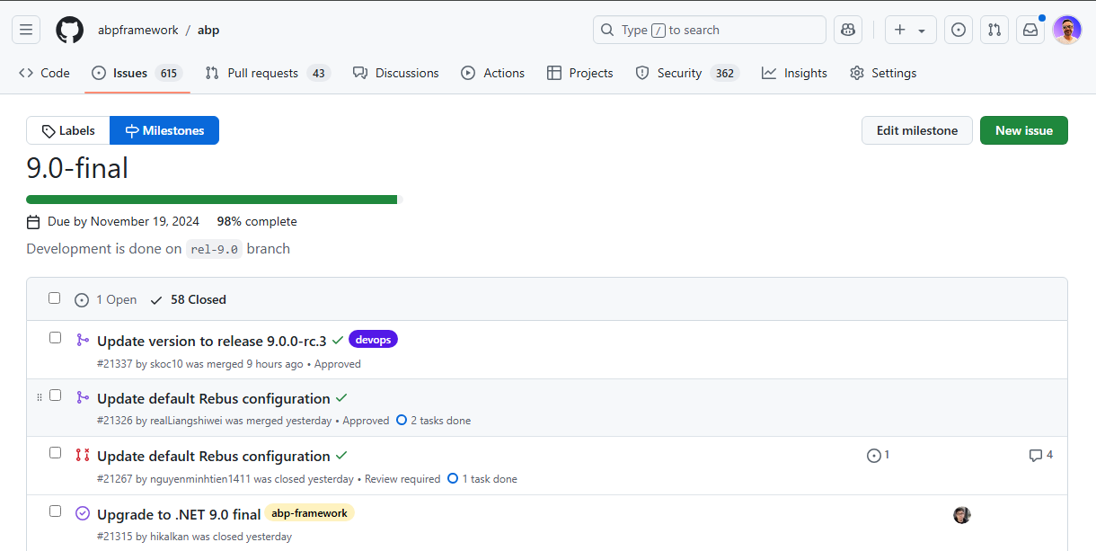
ABP 9 Improvements

Slide 25
ABP Studio Improvements
https://abp.io/docs/latest/studio/release-notes

Slide 26
ABP 9 Improvements — TODO
Highlights for ASP.NET Core & Entity Framework Core features shipped with .NET 9.0
https://abp.io/blog/announcing-abp-9-0-release-candidate
https://abp.io/docs/latest/release-info/road-map
https://abp.io/community/articles/abp-now-supports-.net-9-zpkznc4f
https://volosoft.com/blog/Highlights-for-ASP-NET-Entity-Framework-Core-NET-9-0
https://abp.io/docs/9.0/release-info/migration-guides/abp-9-0
https://github.com/abpframework/abp/milestone/104?closed=1
https://github.com/volosoft/volo/milestone/103?closed=1

Slide 27





That’s all from the community side ☺
Follow me on Twitter
Alper Ebicoglu
https://twitter.com/alperebicoglu
https://github.com/ebicoglu
https://medium.com/@alperonline

